Slide 1



Pulsed Power Control System
Logan Curtis, Dr. Jason Cassibry, Department of Mechanical and Aerospace Engineering
Research and Creative Experience for Undergraduates Program (RCEU)
Summer 2020

Slide 2

What is a Pulsed Power Control System?
A pulsed power control system is a combination of software and hardware solutions that work together to allow for safe operation of a pulsed power device.

Slide 3
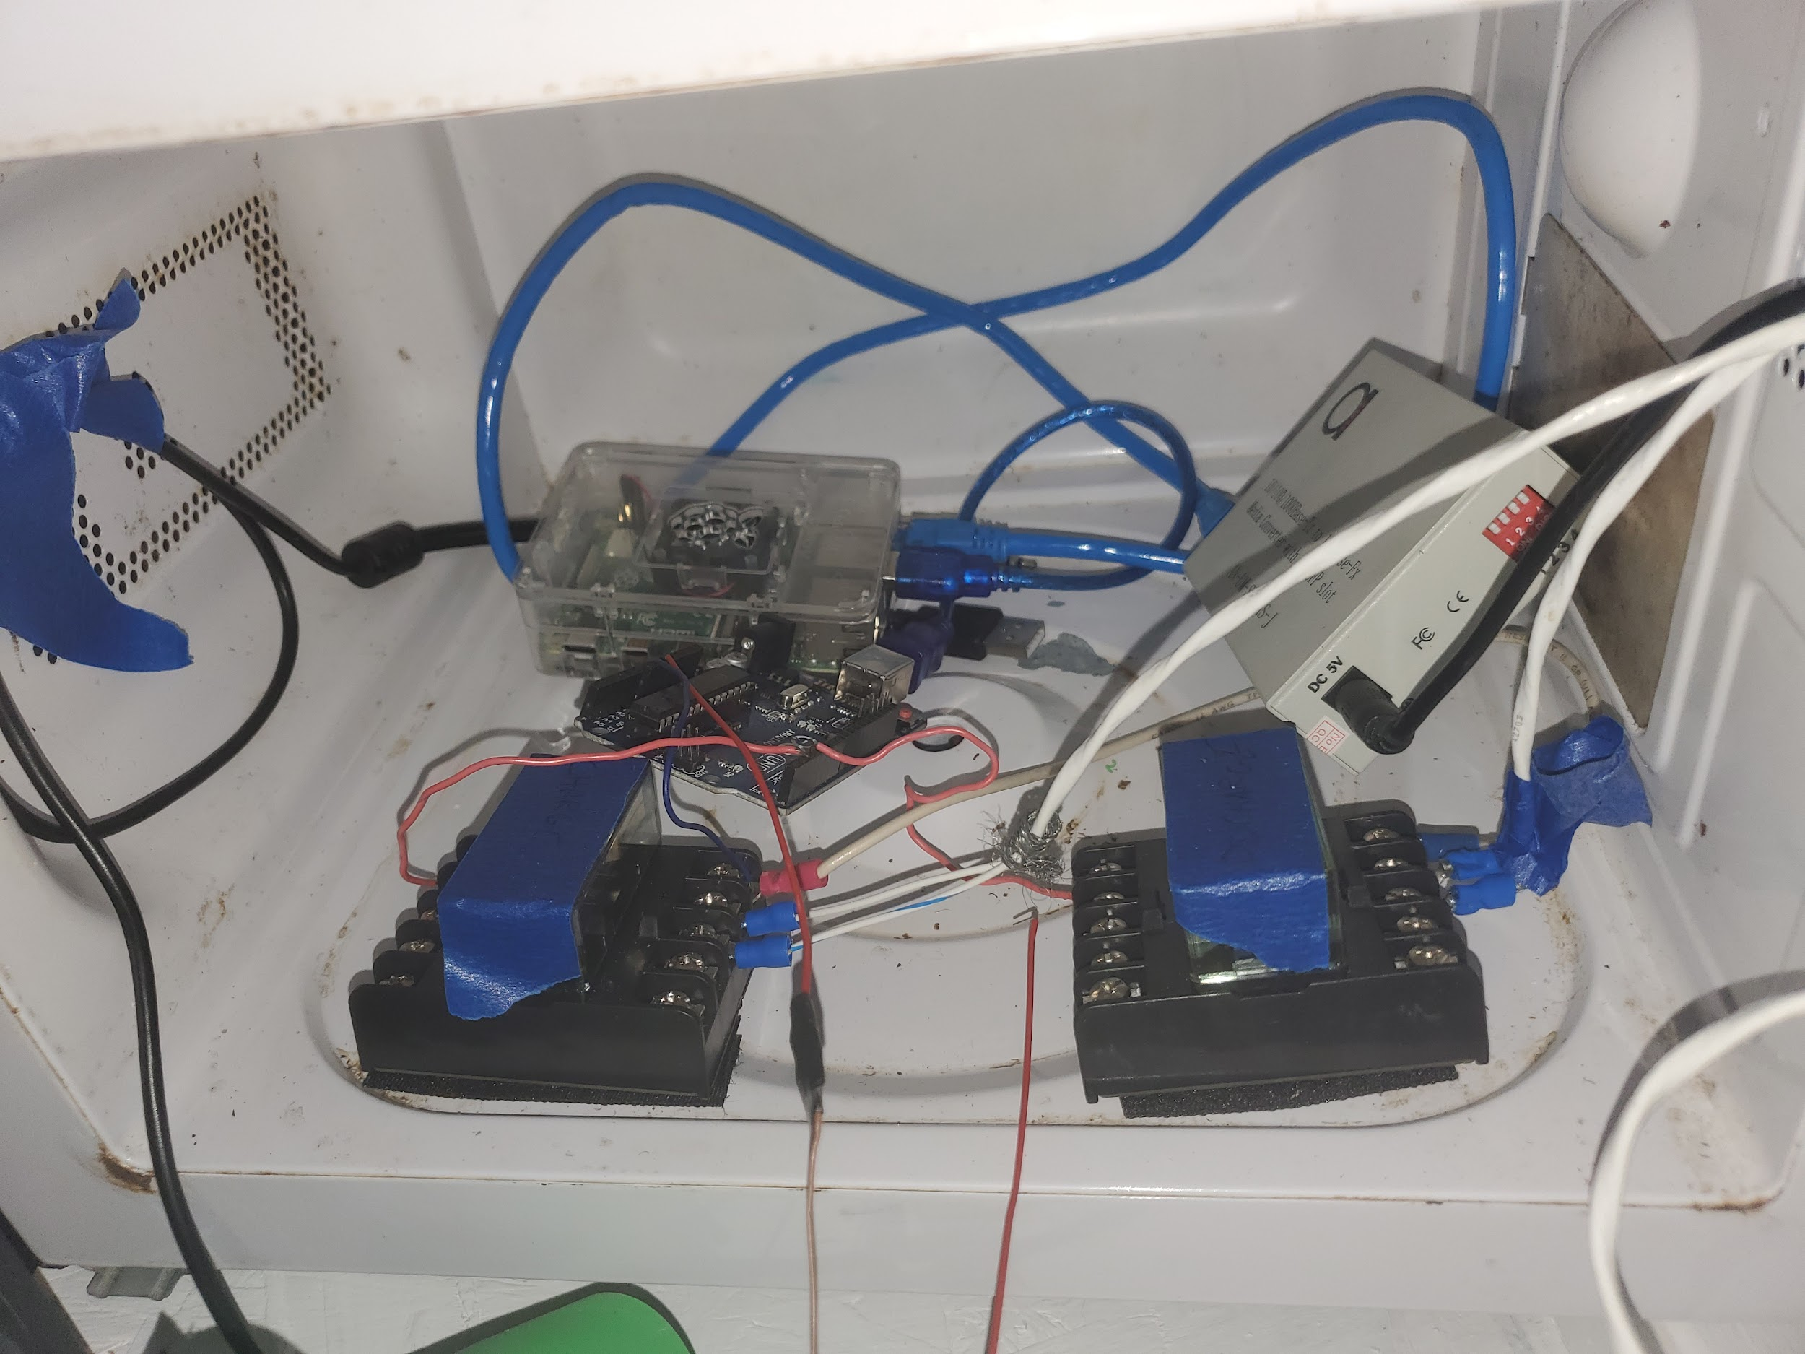
What hardware was used?
The following hardware was used in
the system:
Raspberry Pi 4B
Arduino Uno
2 Ethernet over Fiber Converters

Slide 4
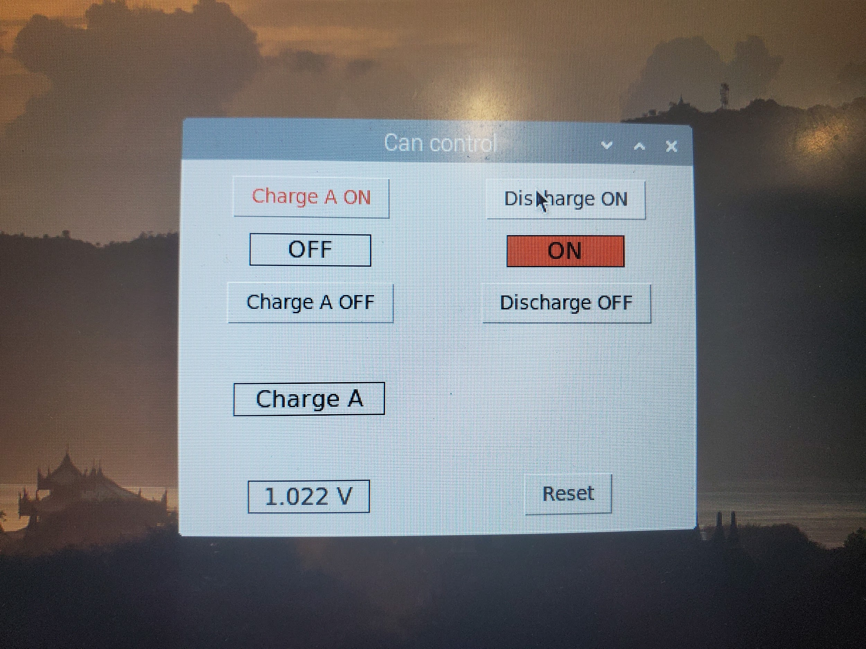
What Software was used?
A custom Control panel was created using python. This software also handles the communication between the Raspberry Pi and the Arduino. Several Safety features are include in the program.

Slide 5
Conclusion
This Control System has been successful in controlling a pulsed power device remotely. This protects the user from high voltage electricity. This solution is also cheaper than other solutions because it Uses off the Shelf Hardware

